Slide 1
Micro credit defaulter
Problem Statement-
A Microfinance Institution (MFI) is an organization that offers financial services to low income populations. MFS becomes very useful when targeting especially the unbanked poor families living in remote areas with not much sources of income. The Microfinance services (MFS) provided by MFI are Group Loans, Agricultural Loans, Individual Business Loans and so on. Many microfinance institutions (MFI), experts and donors are supporting the idea of using mobile financial services (MFS) which they feel are more convenient and efficient, and cost saving, than the traditional high-touch model used since long for the purpose of delivering microfinance services. Though, the MFI industry is primarily focusing on low income families and are very useful in such areas, the implementation of MFS has been uneven with both significant challenges and successes. Today, microfinance is widely accepted as a poverty-reduction tool, representing $70 billion in outstanding loans and a global outreach of 200 million clients. We are working with one such client that is in Telecom Industry. They are a fixed wireless telecommunications network provider. They have launched various products and have developed its business and organization based on the budget operator model, offering better products at Lower Prices to all value conscious customers through a strategy of disruptive innovation that focuses on the subscriber. They understand the importance of communication and how it affects a person’s life, thus, focusing on providing their services and products to low income families and poor customers that can help them in the need of hour. They are collaborating with an MFI to provide micro-credit on mobile balances to be paid back in 5 days. The Consumer is believed to be defaulter if he deviates from the path of paying back the loaned amount within the time duration of 5 days. For the loan amount of 5 (in Indonesian Rupiah), payback amount should be 6 (in Indonesian Rupiah), while, for the loan amount of 10 (in Indonesian Rupiah), the payback amount should be 12 (in Indonesian Rupiah).
the machine learning model will be developed for prediction of the probability of whether the customer will be paying back the loan amount within 5days of loan issuance

Slide 2
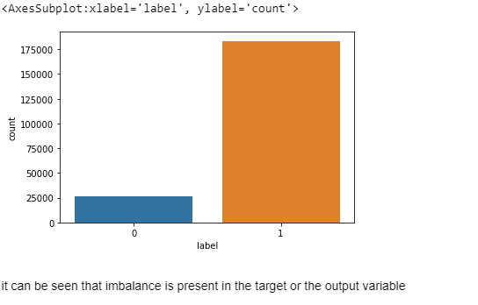
EDA

Slide 3
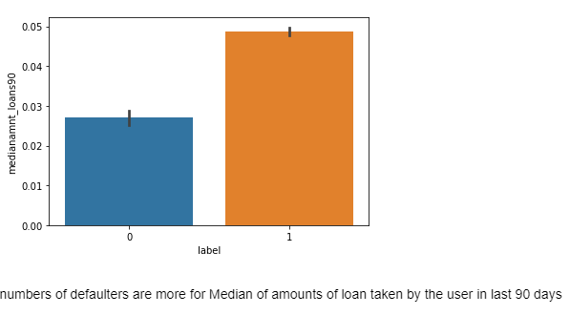
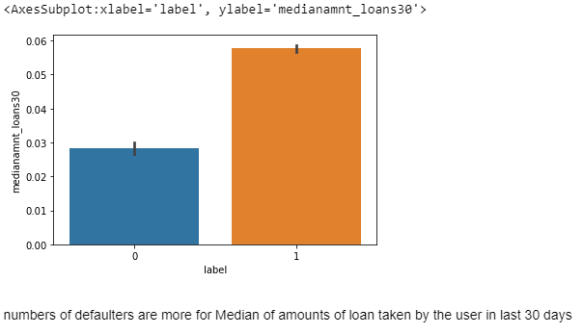
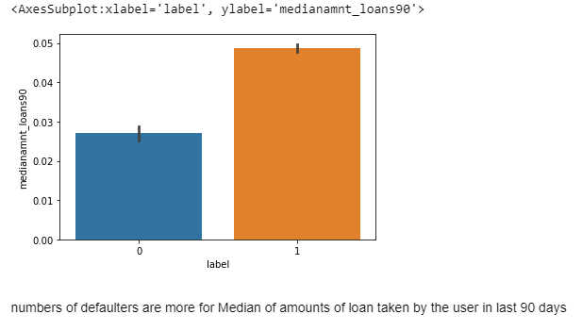
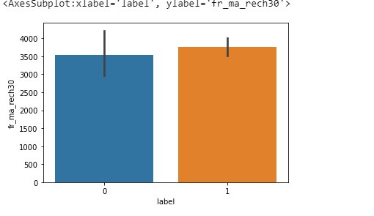
We can see that whether a customer would be a deafulters depends on amounts of loan taken is last 90 days,median of amounts of loan and other factors

Slide 4
From the plots, it can be seen that number of defaulters are more if the median of amounts taken on loan is last 90 days is more than 30 days

Slide 5
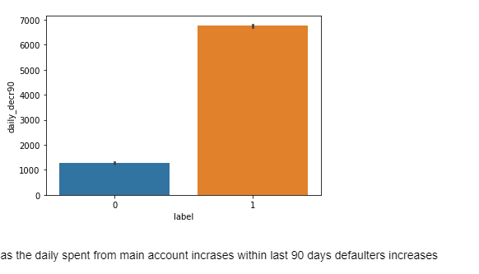
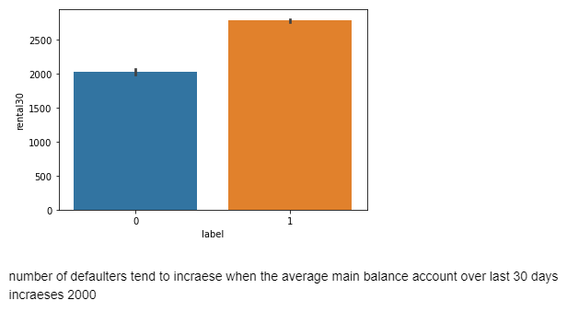
As can be seen the area by car is little useful, but contrary to common sense the multiplication of the area by the number of vacancies yes is. In the division we lose the magnitude and we have to maintain one or another functionality to recover it. With the multiplication we solve the problem of 1 parking space of 10 square feet against another of 10 with 1 square feet each. We could still improve the correlation by 0.06, already considering the exclusion of only 4 outliers. The identification of the outliers was facilitated, note that before we would have a greater number of outliers, since the respective of each features alone are not coincident.
Garage areas and parking

Slide 6
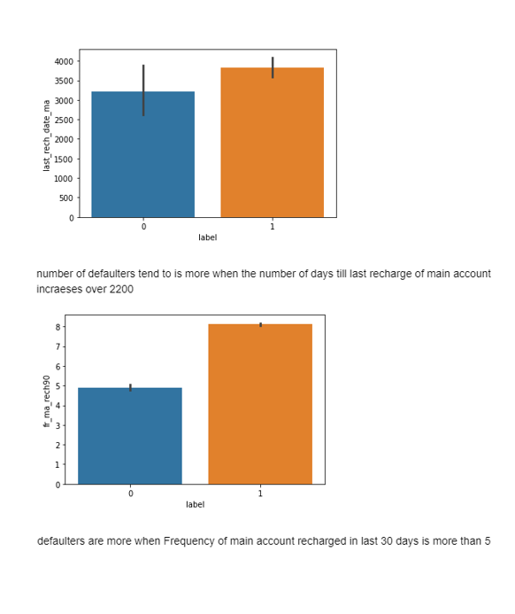
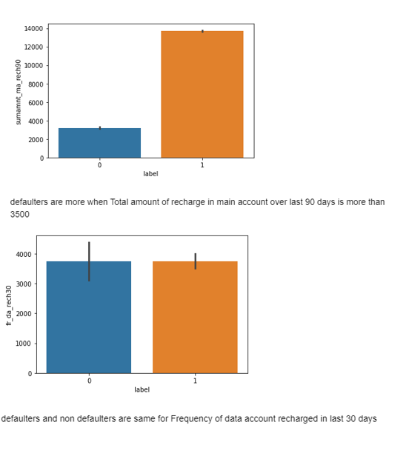
Total Basement Area Vs 1st Floor Area

Slide 7
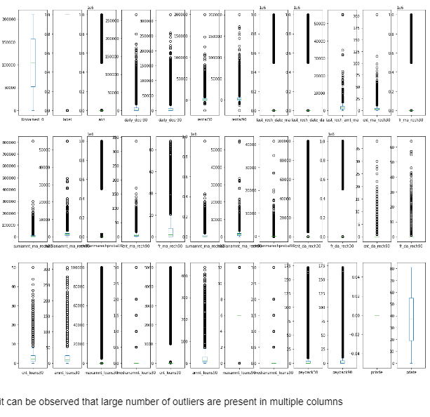
From the box plot,it can be seen that large outliers are present.

Slide 8
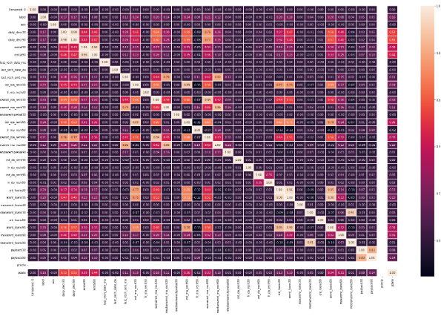
Review Porch Features

